Slide 1



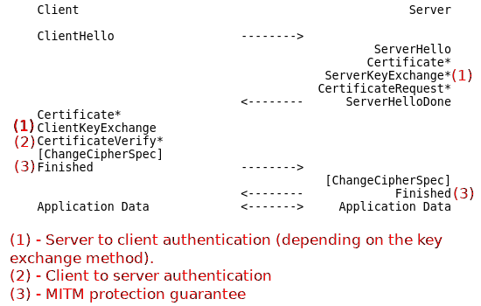
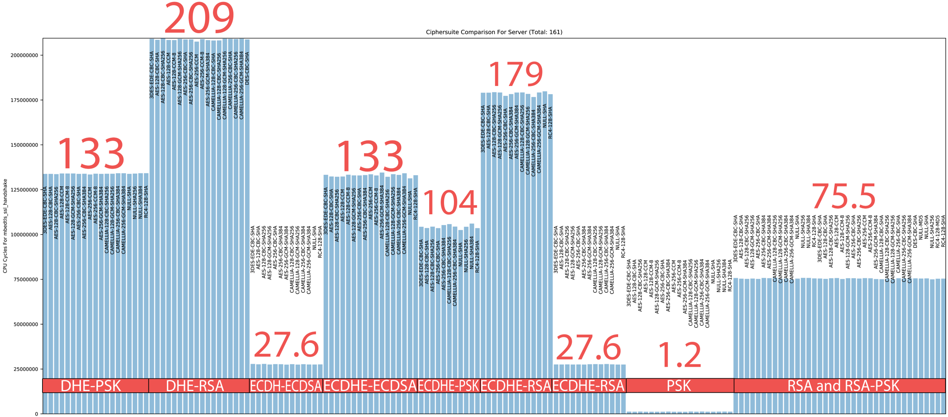
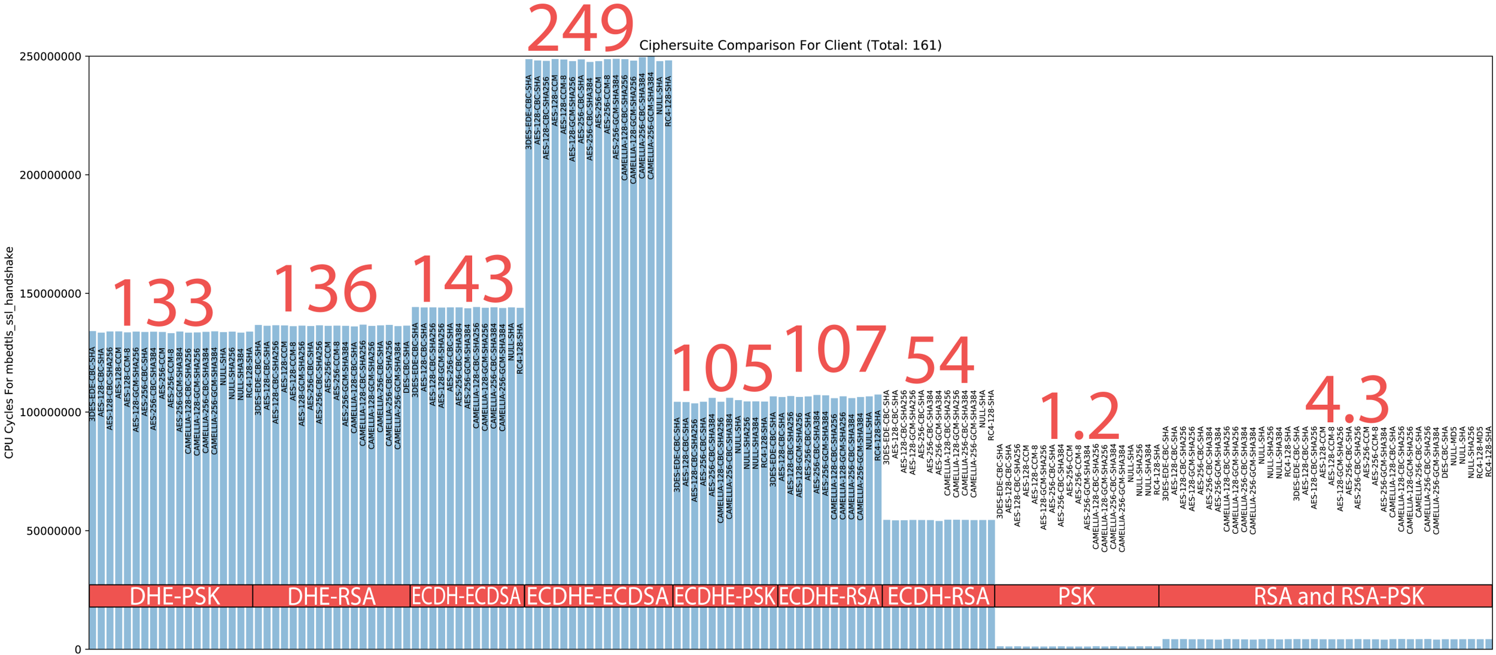
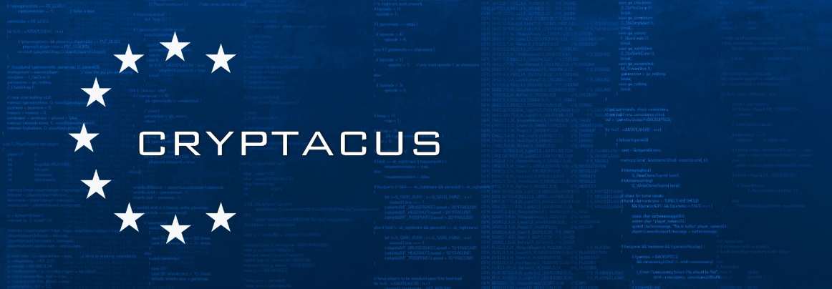
TLS for IOT
Illya Gerasymchuk illya@iluxonchik.me
INESC-ID Investigação e Desenvolvimento, Rua Alves Redol 9, 1000-029 Lisbon, Portugal
Instituto Superior Técnico, Universidade de Lisboa, Av. Rovisco Pais, 1049-001 Lisbon, Portugal
Motivation:
Internet of Things (IoT) lacks security
(D)TLS provides connection security
Too heavy for IoT devices
Code size, resources, energy
Existing work focuses on DTLS
New standards like “CoAP over TLS” call for TLS optimization
Goals:
Profile most important features of TLS
Associate costs with each feature
e.g. How much does PFS cost?
Build a framework that suggests a TLS configuration
Based on the needs and limitation of the environment
e.g. required security services, available power, memory and processing speed
Fully compatible with “vanilla” (D)TLS
Focused on TLS 1.2
Taking into account TLS 1.3 and its features
The Transport Layer Security (TLS) Protocol
Wednesday, April 18th 2018
15:00h
Powers HTTPS (HTTP over TLS)
Client-Server protocol
Connection-oriented and reliable
Main goals:
Data confidentiality and integrity
Two phases:
Negotiate security parameters (Handshake Protocol)
Exchange data securely (Record Protocol)
Security Services:
Authentication
Confidentiality
Integrity
Replay Protection
Perfect Forward Secrecy
Using
Datagram TLS (DTLS) – adaptation of TLS that runs on top of an unreliable transport protocol (e.g. UDP)
While TLS runs on top of a reliable transport protocol, such as TCP
The majority of TLS features is also available in DTLS
Profiling TLS Ciphersuites
Ciphersuite = key exchange alg. + authentication alg. + encryption alg. + PRF (TLS 1.2)
TLS Handshake profiled with each one of the ciphersuites (depicted in graphs)
For both, client and server
Using a tool written for that purpose
mbedTLS’s library TLS implementation
TLS library for embedded devices
Data encryption and MAC algorithms also profiled
Server
Client
Legend
Red rectangles group by key exchange and authentication
Text on bars specifies encryption algorithm and MAC function
Numbers in red represent the number of CPU cycles in millions
valgrind estimates
Analysis
Different results for client and server
Client needs to verify certificate chain (public key operations)
Public key operations are faster than private key ones
Because public RSA exponent is usually small
ECDSA’s signature verification is slower than RSA’s
TLS with Pre-Shared Keys (PSK) is used a lot in constrained devices
Graphs above show why
PFS is costly
ECDH(E) ciphersuites use less CPU cycles than DHE(E)
Future Work
Associate cost with each security service
Profile remaining TLS features
e.g. session resumption
Profile with actual CPU cycles measures
Profile on relevant architectures
Measure power consumption
Build a framework that suggests a TLS configuration

